Slide 1
Strange Encounters

Slide 2
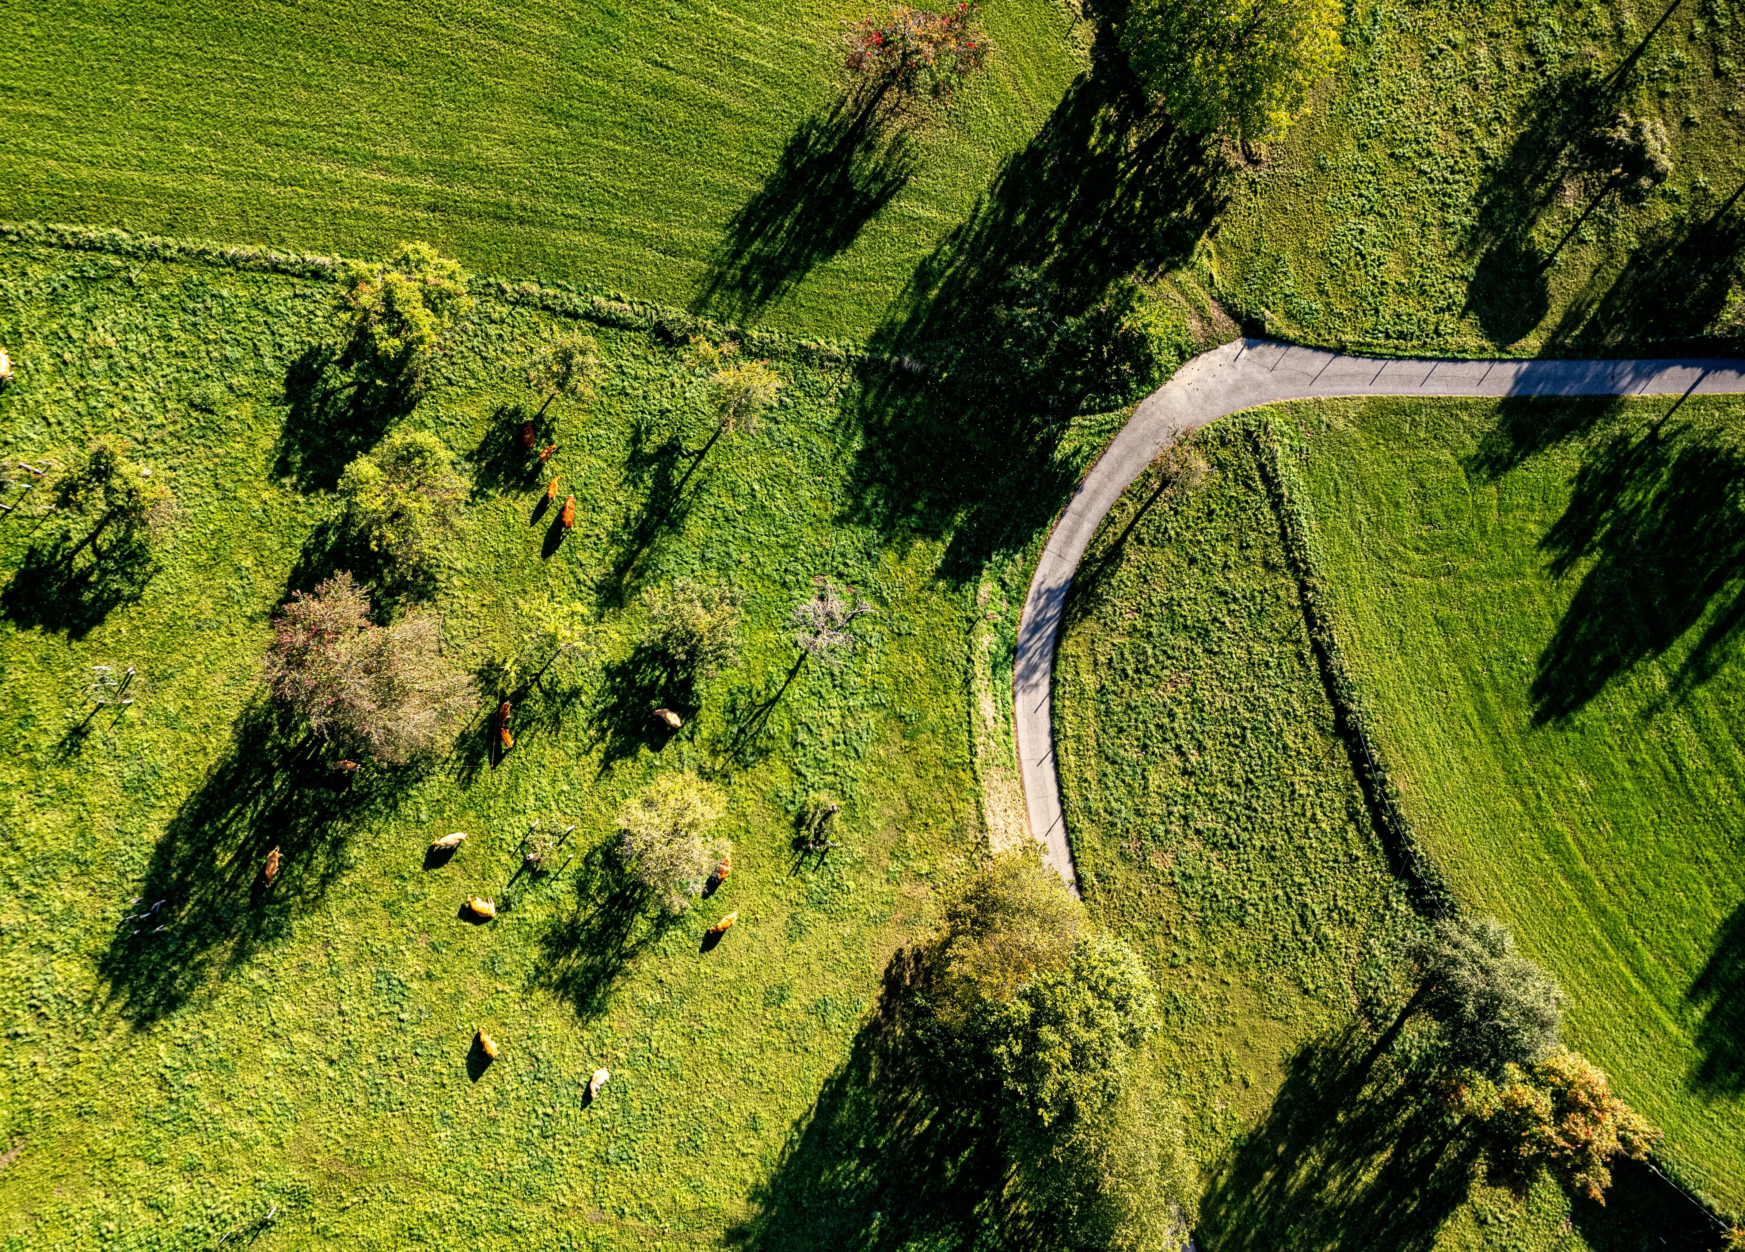
Outlandish Individuals
Queequeg circulating among polite society
Foreign mariners in busy streets
Actual cannibals in New Bedford

Slide 3
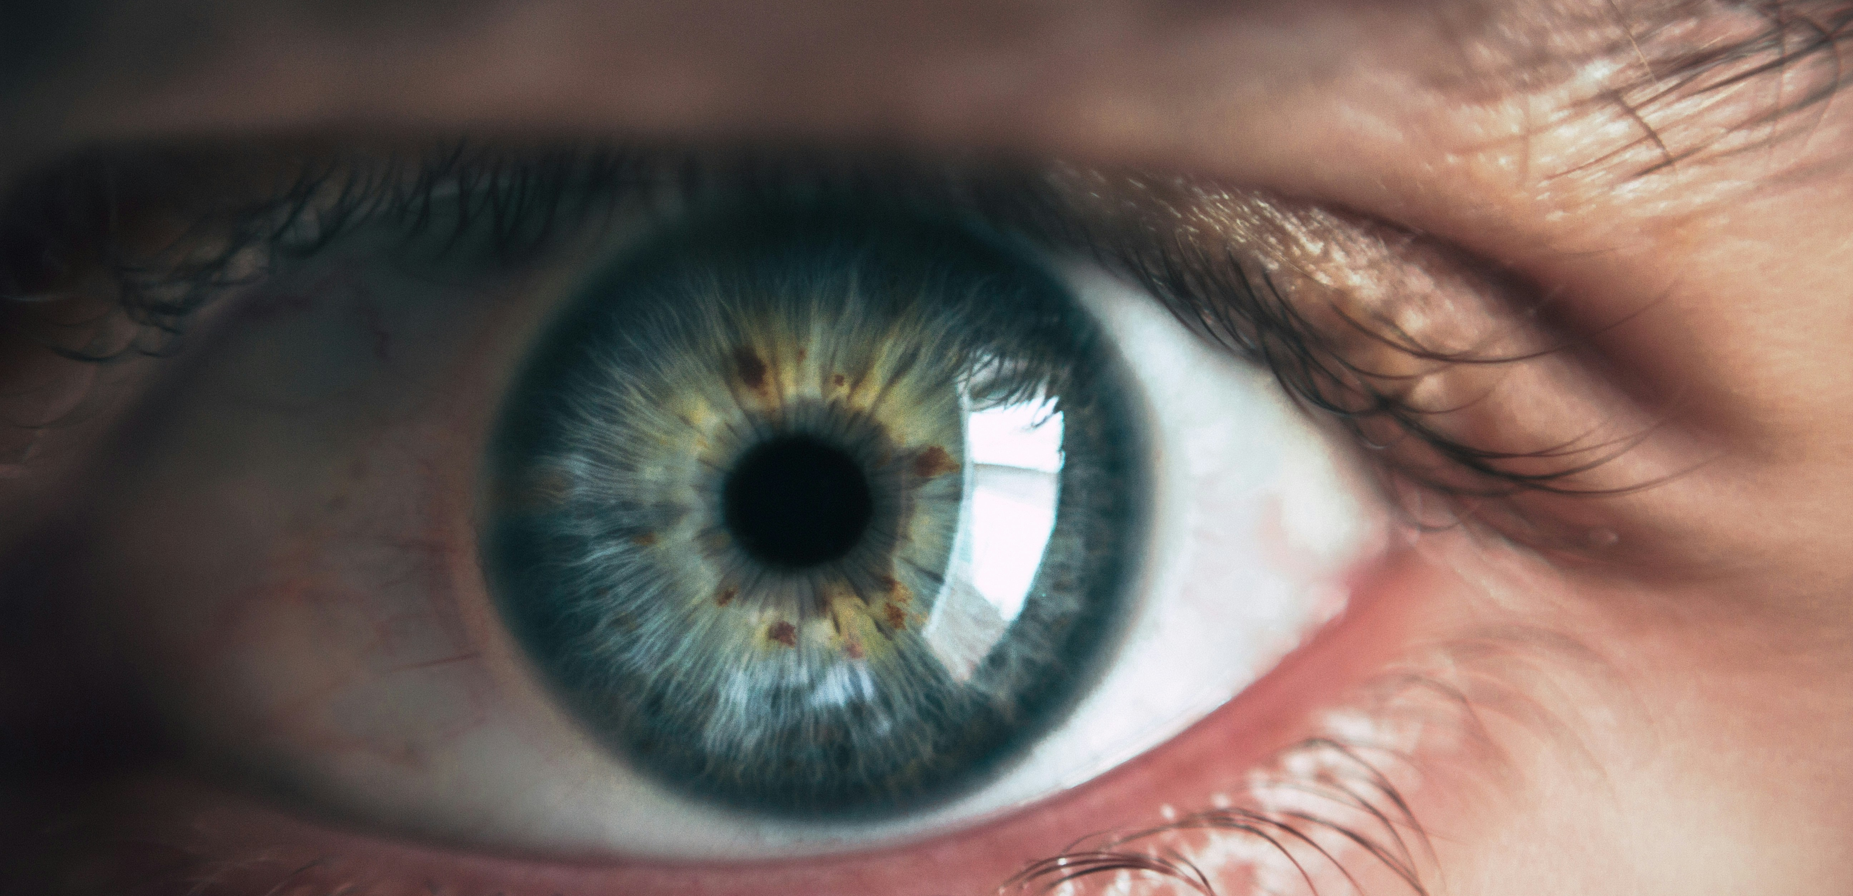
Unholy Flesh

